Slide 1
Theory of Automata
Lecture # 08
Dr. Muhammad Fayaz

Slide 2
Union of Two FAs

Slide 3
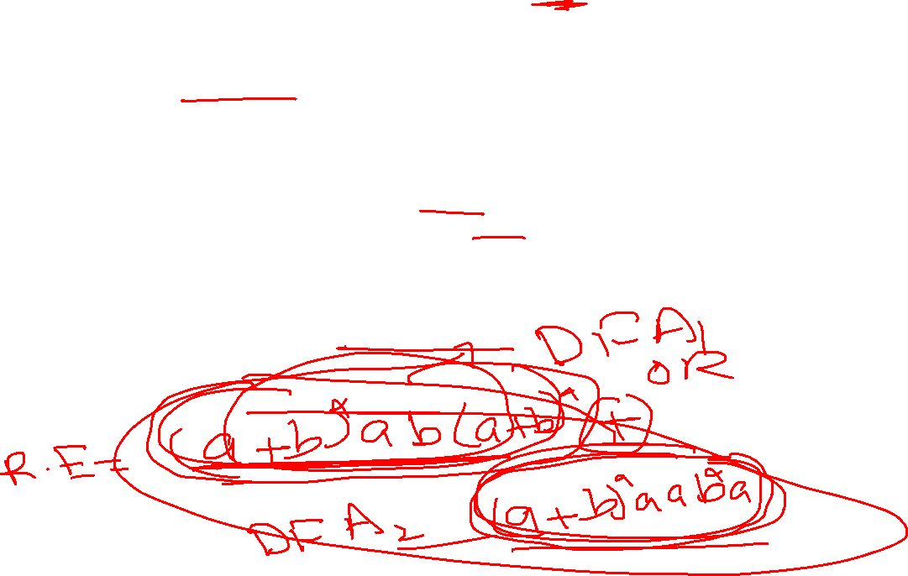
Union of two FAs
Method (Using the FAs corresponding to r₁ and r₂ an FA can be built, corresponding to r₁+ r₂.
Let FA3 be an FA corresponding to r1+ r2, then the initial state of FA3 must correspond to the initial state of FA1 and the initial state of FA2.
Since the language corresponding to r₁+ r₂ is the union of corresponding languages L₁ and L₂, consists of the strings belonging to L₁or L₂ or both, therefore a final state of FA₃ must correspond to a final state of FA₁ or FA₂ or both.

Slide 4

Example
Old States | New States after reading
 | a | b
z₁– =(x₁,y₁) | (x₁,y₂) =z₂ | (x₂,y₁) = z₃
z₂ =(x₁,y₂) | (x₁,y₃) =z₄ | (x₂,y₁) = z₃
z₃+ =(x₂,y₁) | (x₁,y₂) = z₂ | (x₂,y₁) = z₃
z₄+ =(x₁,y₃) | (x₁,y₃) = z₄ | (x₂,y₃) = z₅
z₅+ =(x₂,y₃) | (x₁,y₃) = z₄ | (x₂,y₃) = z₅
Let r₁=(a+b)*b defines L₁ and the FA₁ be
and r₂ = (a+b )*aa(a+b )* defines L₂ and FA₂ be
a
b
b
X₁–
X₂+
a
Z₂
b
a,b
a
a
a
a
b
a
b
y₁-
y₂
y₃+
Z₁-
a
b
Z₄ +
Z₅ +
b
b
a
Z₃+
b
1.The initial state of FA3 must correspond to the initial state of FA1 and the initial state of FA2.
2. The final state of FA₃ must correspond to a final state of FA₁ or FA₂ or both.
RE corresponding to the above FA may be
r₁+r₂ = (a+b)*b + (a+b )*aa(a+b )*

Slide 5
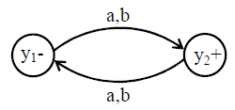

Example
Old States | New States after reading
 | a | b
z₁-=(x₁,y₁) | (x₂,y₂) =z₂ | (x₁,y₂) = z₃
z₂+=(x₂,y₂) | (x₂,y₁) =z₄ | (x₁,y₁) = z₁
z₃+ =(x₁,y₂) | (x₂,y₁) =z₄ | (x₁,y₁) = z₁
z₄+ =(x₂,y₁) | (x₂,y₂) = z₂ | (x₁,y₂) = z₃
Let r₁= ((a +b)*a defines L₁ and FA₁ be
and r₂= ((a + b)(a + b))*(a+b) defines L₂ and FA₂ be
b
a
a
a
X₁–
X₂+
z₁-
z₂+
b
b
b
b
a
a
a
z₃+
z₄+
1.The initial state of FA3 must correspond to the initial state of FA1 and the initial state of FA2.
2. The final state of FA₃ must correspond to a final state of FA₁ or FA₂ or both.
b

Slide 6

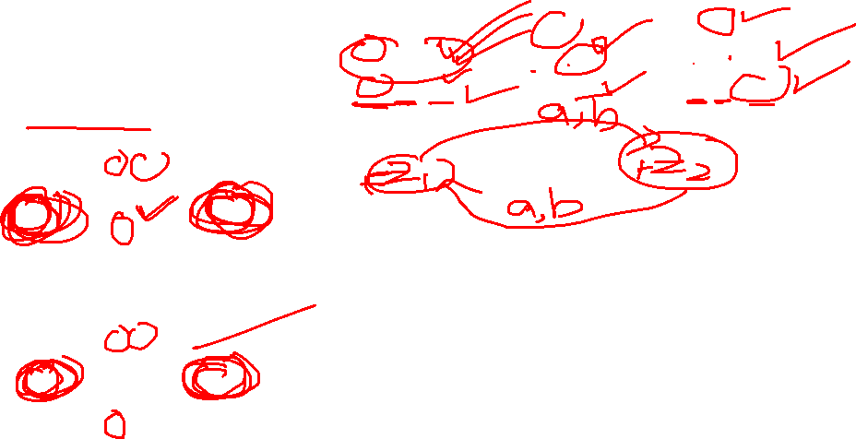
Example
Old States | New States after reading
 | a | b
z₁±=(x₁,y₁) | (x₂,y₂) =z₂ | (x₂,y₂) = z₂
z₂+=(x₂,y₂) | (x₁,y₁) =z₁ | (x₁,y₁) = z₁
Let r₁= ((a + b)(a + b))* defines L₁ and FA₁ be
and r₂= ((a + b)(a + b))* (a+b) defines L₂ and FA₂ be
a , b
z₁ ±
z₂+
a,b
DFA3
1.The initial state of FA3 must correspond to the initial state of FA1 and the initial state of FA2.
2. The final state of FA₃ must correspond to a final state of FA₁ or FA₂ or both.

Slide 7
Practice

Slide 8
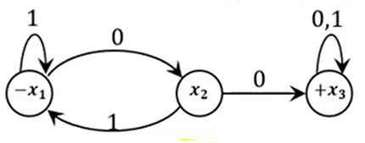
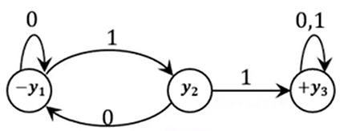
Example: Union of Two FAs
FA₁
FA₂

Slide 9
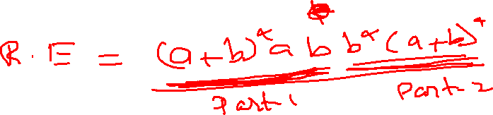
Concatenation of Two FAs

Slide 10
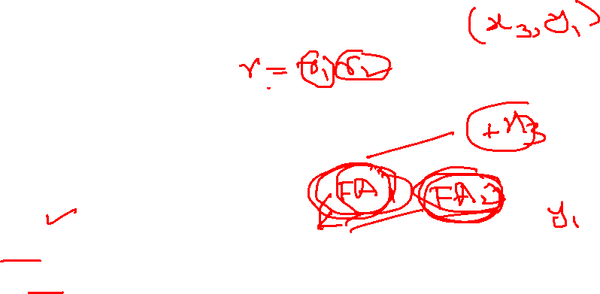
Concatenation of Two FAs
Using the FAs corresponding to r₁ and r₂, an FA can be built, corresponding to r₁r₂.
This method can be developed considering the following examples
Let FA₃ be an FA corresponding to r₁r₂, then the initial state of FA₃ must correspond to the initial state of FA₁ and the final state of FA₃ must correspond to the final state of FA₂.
The moment a final state of first FA₁ is entered, the possibility of the initial state of second FA₂ will be included as well

Slide 11
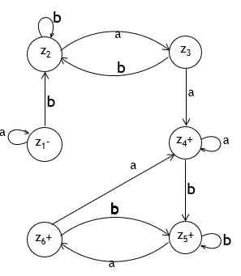
Example
Old States | New States after reading
 | a | b
z₁-=x₁ | x₁=z₁ | (x₂,y₁)= z₂
Z₂=(x₂,y₁) | (x₁,y₂)=z₃ | (x₂,y₁)= z₂
Z₃=(x₁,y₂) | (x₁,y₃)=z₄ | (x₂,y₁)= z₂
z₄+=(x₁,y₃) | (x₁,y₃)=z₄ | (x₂,y₁,y₃)= z₅
z₅+=(x₂,y₁,y₃) | (x₁,y₂ ,y₃)= z₆ | (x₂,y₁,y₃)= z₅
z₆+=(x₁,y₂,y₃) | (x₁,y₃)= z₄ | (x₂ ,y₁,y₃)= z₅
a
b
b
X₁–
X₂+
a
Let r₁=(a+b)*b defines L₁ and FA₁ be
and r₂ = (a+b )*aa (a+b )* defines L₂ and FA₂ be
a,b
b
a
y₁-
y₂
a
y₃+
b
The initial state of FA₃ must correspond to the initial state of FA₁
The final state of FA₃ must correspond to the final state of FA₂.
The moment a final state of first FA₁ is entered, the initial state of second FA₂ will be included as well
FA3

Slide 12
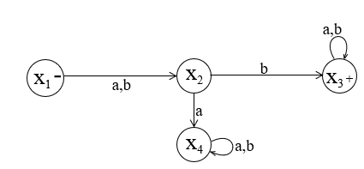
Example
Old States | New States after reading
 | a | b
z₁-=x₁ | X₂=z₂ | X₂= z₂
Z₂=x₂ | x₄=z₃ | (x₃,y₁)=z₄
z₃ =x₄ | x₄=z₃ | x₄=z₃
z₄=(x₃,y₁) | (x₃ ,y₁,y₂)= z₅ | (x₃,y₁)= z₄
z₅+=(x₃,y₁ ,y₂) | (x₃ ,y₁ ,y₂)= z₅ | (x₃,y₁ ,y₂)= z₅
Let r₁=(a + b) b ( a + b )* defines L₁ and FA₁ be
and r₂ = a (b*aab*)* defines L₂ and FA₂ be
b
a,b
z₄
a
z₅
+
a ,b
b
-
z₁
z₂
b
a
b
a,b
a
y₁ -
y₂+
FA3
a
z₃
The initial state of FA₃ must correspond to the initial state of FA₁
The final state of FA₃ must correspond to the final state of FA₂.
The moment a final state of first FA₁ is entered, the initial state of second FA₂ will be included as well

Slide 13
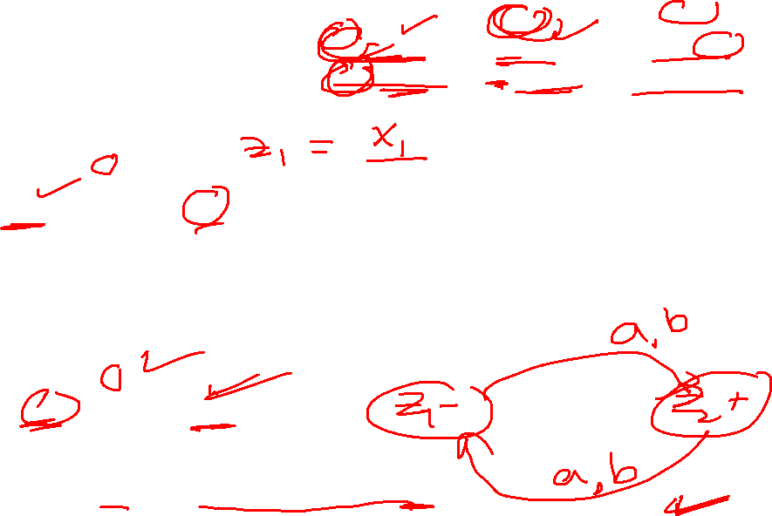
Example
Old States | New States after reading
 | a | b
Z₁- = (x₁,y₁) | (x₂,y₂) =z₂ | (x₂,y₂) = z₂
z₂+=(x₂,y₂) | (x₁,y₁) =z₁ | (x₁,y₁) = z₁
Let r₁= ((a + b)(a + b))* defines L₁ and FA₁ be
and r₂= ((a + b)(a + b))* (a+b) defines L₂ and FA₂ be
a , b
Z₁-
z₂+
a,b
FA3
The initial state of FA₃ must correspond to the initial state of FA₁
The final state of FA₃ must correspond to the final state of FA₂.
The moment a final state of first FA₁ is entered, the initial state of FA₂ will be included as well

Slide 14
Practice

Slide 15

Example: Concatenation of Two FAs
FA₂
FA₁

Slide 16
Thanks

